Slide 1
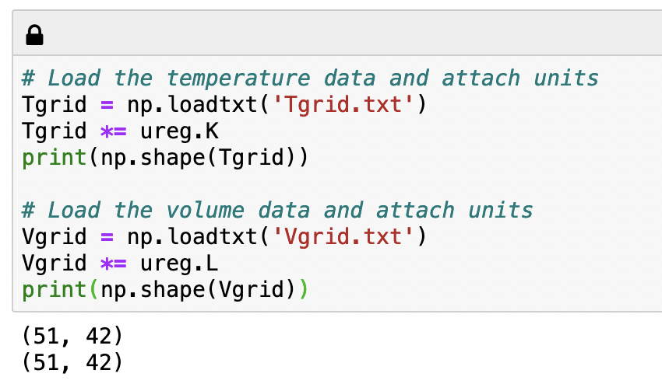
Tgrid: representation of the temperature state space
51 temperatures
42 volumes
V
T
Tgrid is a grid = T,V state space

Slide 2
Temperature along an isochore
Tgrid
51 temperatures
42 volumes
V
T
51 temperatures, ranging from 200 to 400 K
Tisochore = [200.0 204.0 208.0 212.0 216.0 220.0 … 400]

Slide 3
Temperature along an isotherm
Tgrid
51 temperatures
42 volumes
V
T
42 temperatures, all 200 K (1st isotherm)
Tisotherm = [200.0 200.0 200.0 200.0 200.0 … 200.0 ]

Slide 4
Temperature along another isotherm
Tgrid
51 temperatures
42 volumes
V
T
42 temperatures, all 204 K (2nd isotherm)
Tisotherm = [204.0 204.0 204.0 204.0 204.0 … 204.0 ]

Slide 5

Vgrid: representation of the volume state space
51 temperatures
42 volumes
V
T
Vgrid is also a grid = T,V state space

Slide 6
Volume along an isochore
Vgrid
51 temperatures
42 volumes
V
T
51 values, all 1 Liter
Visochore = [1.0 1.0 1.0 1.0 1.0 … 1.0]

Slide 7
Volume along an isotherm
Vgrid
51 temperatures
42 volumes
V
T
51 values, all 2 Liter
Visochore = [2.0 2.0 2.0 2.0 2.0 … 2.0]

Slide 8
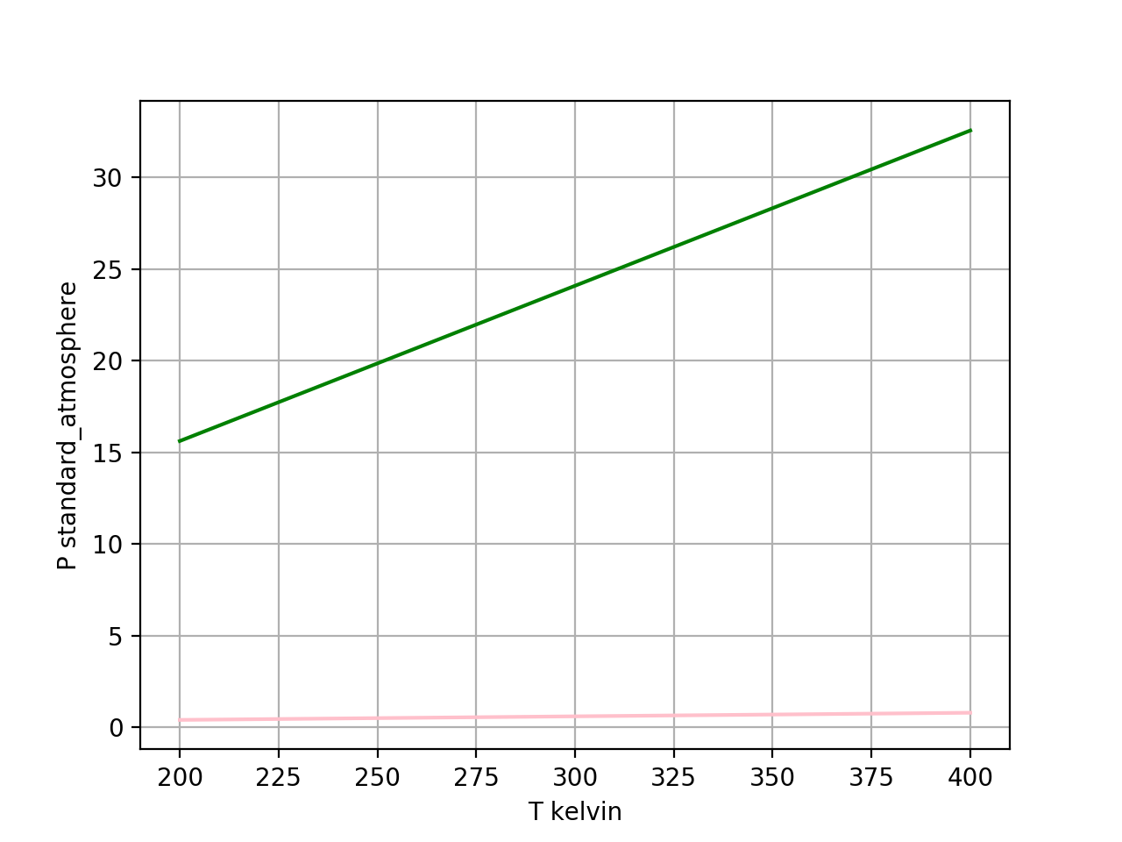
Plotting pressure as a function of temperature along an isochore
V = 1 Liter isochore
V = 42 Liters isochore

Slide 9
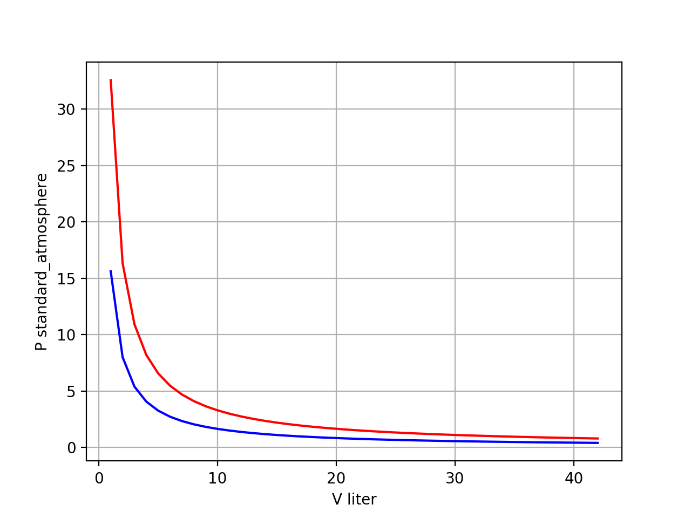
Plotting pressure as a function of volume along an isotherm (“Boyle isotherms”)
T = 400 K isotherm
T = 200 K isotherm

Slide 10


Numerical derivatives
$P(V)$
$${\left(\frac{∂P}{∂V}\right)}_{T}$$

Slide 11
